Slide 1
NATURAL LANGUAGE PROCESSING (LECTURE 2)
Engr. Ahrar Bin Aslam
ahrarbaslam23@gmail.com

Slide 2
Corpus, Documents, Paragraphs, Sentences, Tokens
A Corpus is defined as a collection of text documents for example a data set containing news is a corpus or the tweets containing Twitter data is a corpus. So, corpus consists of documents, documents comprise paragraphs, paragraphs comprise sentences and sentences comprise further smaller units which are called Tokens.
Corpus> Documents > Paragraphs > Sentences > Tokens

Slide 3
Tokenization
Tokenization is a process of splitting a text object into smaller units which are also called tokens. Examples of tokens can be words, numbers, engrams, or even symbols.
The most commonly used tokenization process are:
Word Tokenization
Sentence Tokenization
White-space Tokenization.
Regular Expression Tokenization

Slide 4
WHITE SPACE TOKENIZATION
Also known as unigram tokenization. In this process, the entire text is split into words by splitting them from white spaces.
For example, in a sentence- “I went to New-York to play football.”
This will be splitted into following tokens: “I”, “went”, “to”, “New-York”, “to”, “play”, “football.”
Notice that “New-York” is not split further because the tokenization process was based on whitespaces only.

Slide 5
Regular Expression Tokenization
The other type of tokenization process is Regular Expression Tokenization, in which a regular expression pattern is used to get the tokens. For example, consider the following string containing multiple delimiters such as comma, semi-colon, and white space.
Sentence= “Football, Cricket; Golf Tennis“
Tokens= “Football”, ”Cricket”, “Golf”, “Tennis”
Tokenization can be performed at the sentence level or at the world level or even at the character level.

Slide 6
Stemming
Stemming is a technique used to extract the base form of the words by removing affixes from them. It is just like cutting down the branches of a tree to its stems. For example, the stem of the words eating, eats, eaten is eat.
For example, “laughing”, “laughed“, “laughs”, “laugh” will all become “laugh”, which is their stem, because their inflection form will be removed.

Slide 7
Stemming is not a good normalization process because sometimes stemming can produce words that are not in the dictionary. For example, consider a sentence: “His teams are not winning”
After stemming the tokens that we will get are- “hi”, “team”, “are”, “not”, “winn”
Notice that the keyword “winn” is not a regular word and “hi” changed the context of the entire sentence.

Slide 8
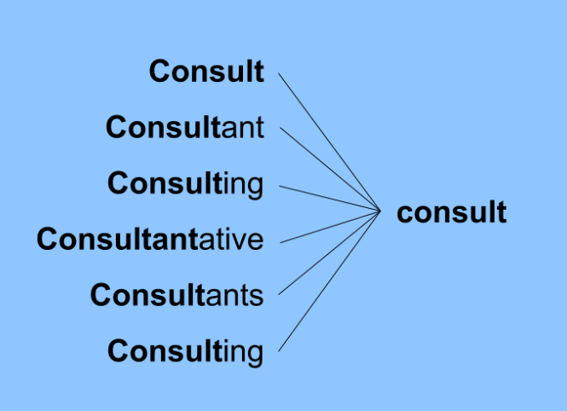
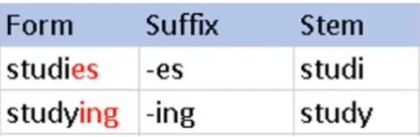

Slide 9
Lemmatization
The purpose of lemmatization is same as that of stemming but overcomes the drawbacks of stemming. In stemming, for some words, it may not give may not give meaningful representation. Here, lemmatization comes into picture as it gives meaningful word.
Lemmatization takes more time as compared to stemming because it finds meaningful word/ representation. Stemming just needs to get a base word and therefore takes less time.

Slide 10
In other words, to lemmatize a document typically means to “doing things correctly” since it involves using a vocabulary and performing analysis of words to remove only the ends and return the base or dictionary form of a word, which is known as the “lemma.”
For example, you can expect a lemmatization algorithm to map “runs,” “running,” and “ran” to the lemma, “run.”
For instance, stemming the word 'Caring' would return 'Car'. For instance, lemmatizing the word 'Caring' would return 'Care’.

Slide 11
Part of Speech (POS) Tagging
POS tagging, also known as part-of-speech tagging or grammatical tagging, is the process of assigning grammatical tags or labels to the words in a given text based on their part of speech. Each word in a sentence is tagged with a specific category that represents its syntactic role and grammatical function in the sentence.
The main purpose of POS tagging is to analyze and understand the structure of a sentence by identifying the part of speech of each word. The part of speech indicates how a word functions in a sentence, such as whether it is a noun, verb, adjective, adverb, pronoun, conjunction, preposition, or other grammatical category.

Slide 12
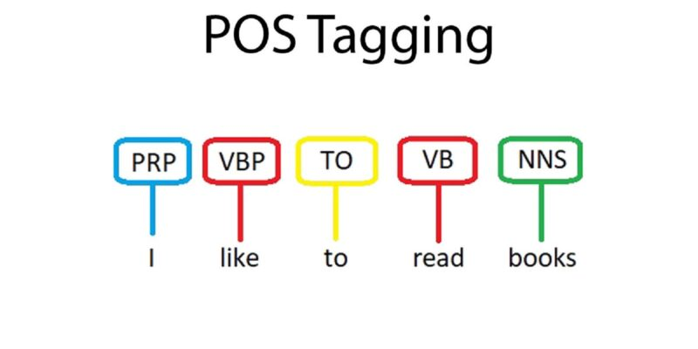
By labeling each word with its corresponding part of speech, it becomes easier to perform various natural language processing (NLP) tasks like text analysis, information extraction, sentiment analysis, machine translation, and more.
For example, given the sentence: "The cat is sitting on the mat," a POS tagger would assign tags to each word as follows:

Slide 13
"The" - determiner
"cat" - noun
"is" - verb
"sitting" - verb
"on" - preposition
"the" - determiner
"mat" - noun

Slide 14
NAMED ENTITY RECOGINITION:
Named Entity Recognition (NER) is a task of Natural Language Processing (NLP) that involves identifying and classifying named entities in a text into categories such as person names, organizations, locations, and others.
The goal of NER is to extract structured information from unstructured text data and represent it in a machine-readable format.

Slide 15
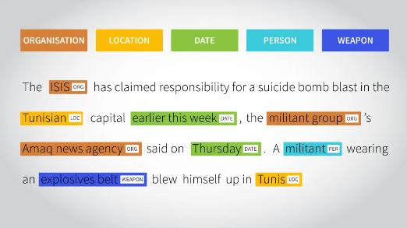
For example, in the sentence “Mark Zuckerberg is one of the founders of Facebook, a company from the United States” we can identify three types of entities:
“Person”: Mark Zuckerberg
“Company”: Facebook
“Location”: United States

